Slide 1
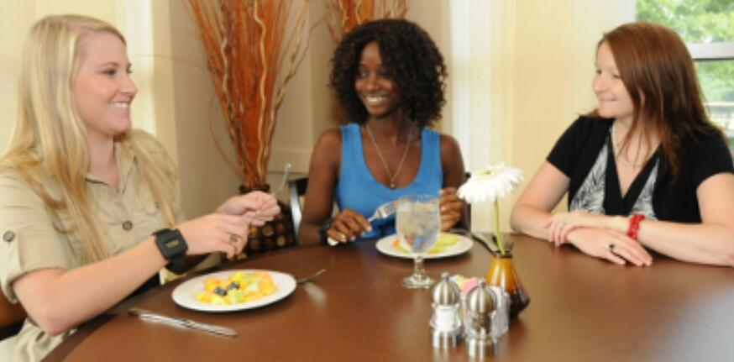


Using Contextual Information to Improve Hidden Markov Model Recognition of Wrist Motions During Eating Activities
Yiru Shen
Committee Members:
Dr. Adam Hoover (Chair)
Dr. Jon Calhoun
Dr. Eric Muth
Dr. Yongqiang Wang

Slide 2

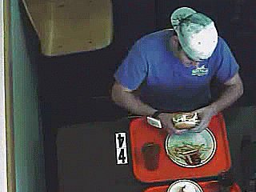
Outline
Introduction
Non-HMM algorithm for eating detection: 1 word
Lexicography of hand gestures during eating: 5 words
Impact of the quantity of training data and model complexity: 5 words
Contextual dependent hidden Markov models: 5 words, multiple dialects

Slide 3
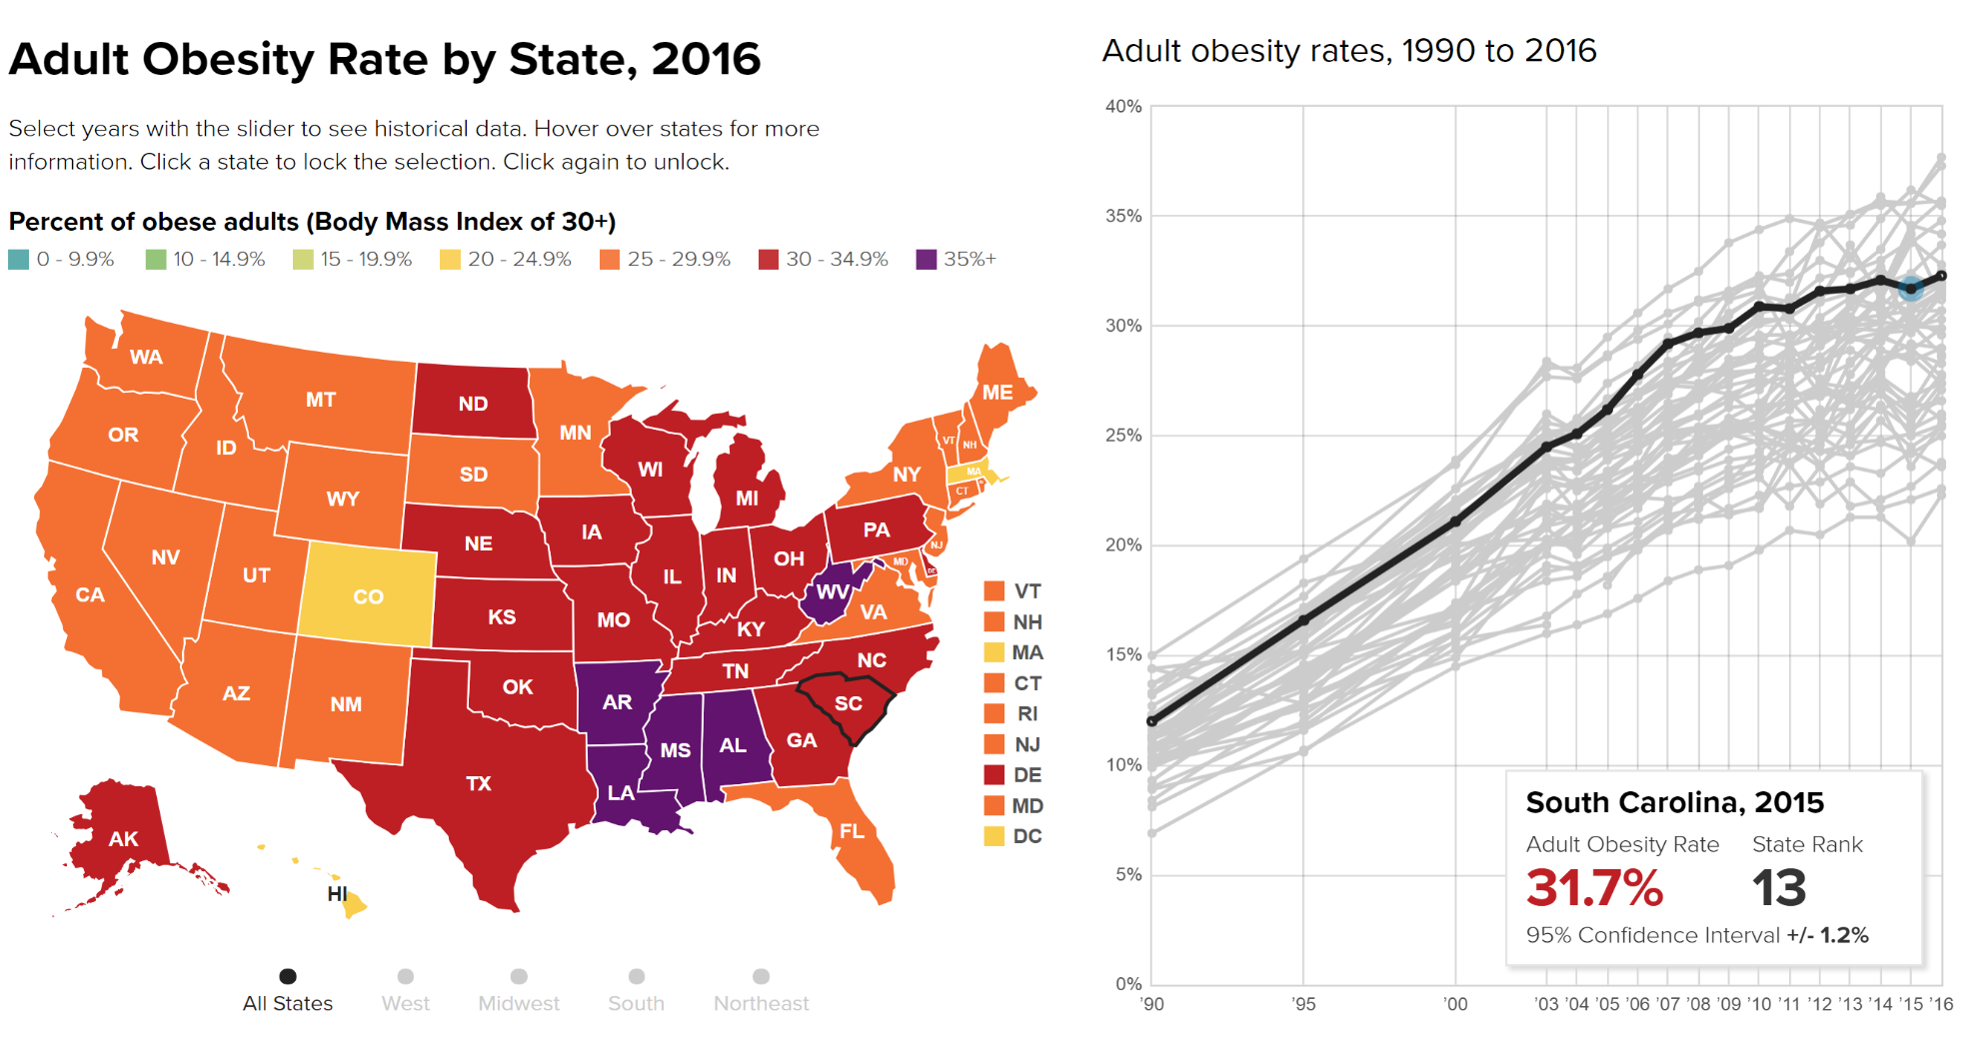
Motivating Health Problem
Prevalence of obesity in USA
Children: 31.2% of children in age between 10 and 17 are overweight or obese
Adults: 39.6% of adults are obese and prevalence is increased among women, in age between 40 and 59 years and 60 years or older. (HC et al. 2018)
(the STATE of OBESITY, updated at Aug. 31, 2017)

Slide 4
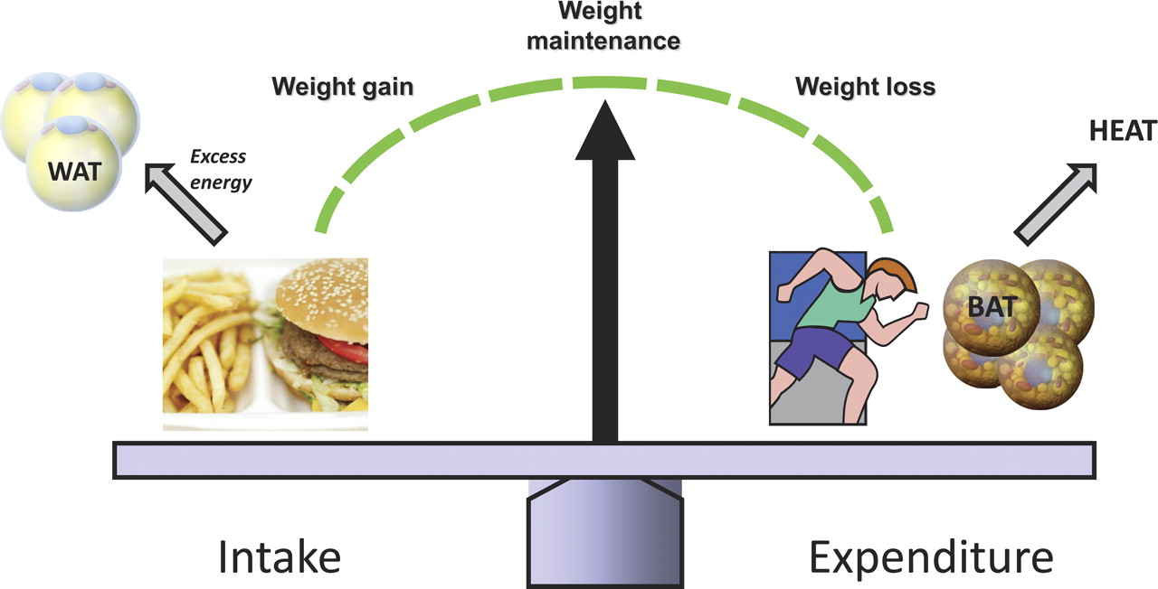
Energy Measures
Energy Intake (EI): Energy absorbed through food intake (Calories or Joules)
Energy Expenditure (EE): Energy needed to carry out a physical function such as breathing, digesting food, or physical movement (Calories or Joules)
WAT: white adipose tissue
BAT: brown adipose tissue
Image source: Seale P, et al., Brown fat in humans: turning up the heat on obesity.

Slide 5
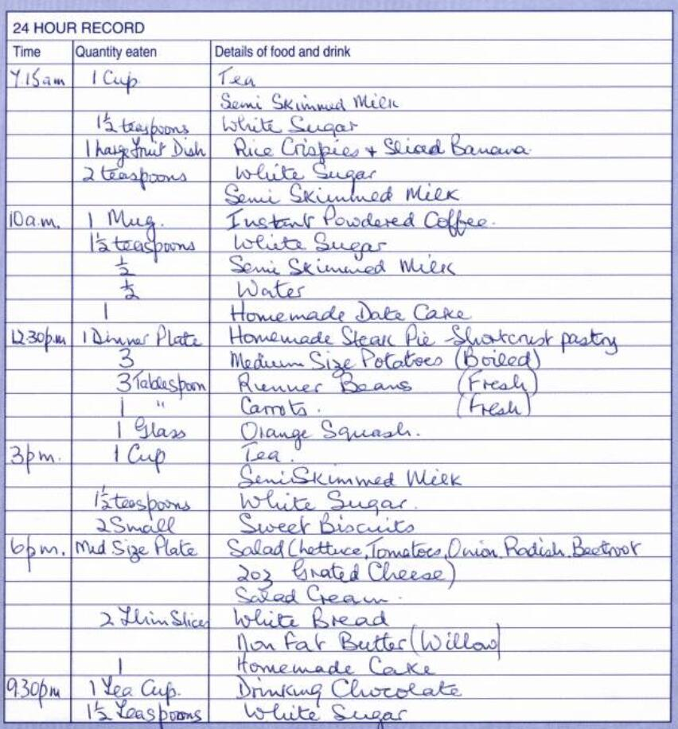
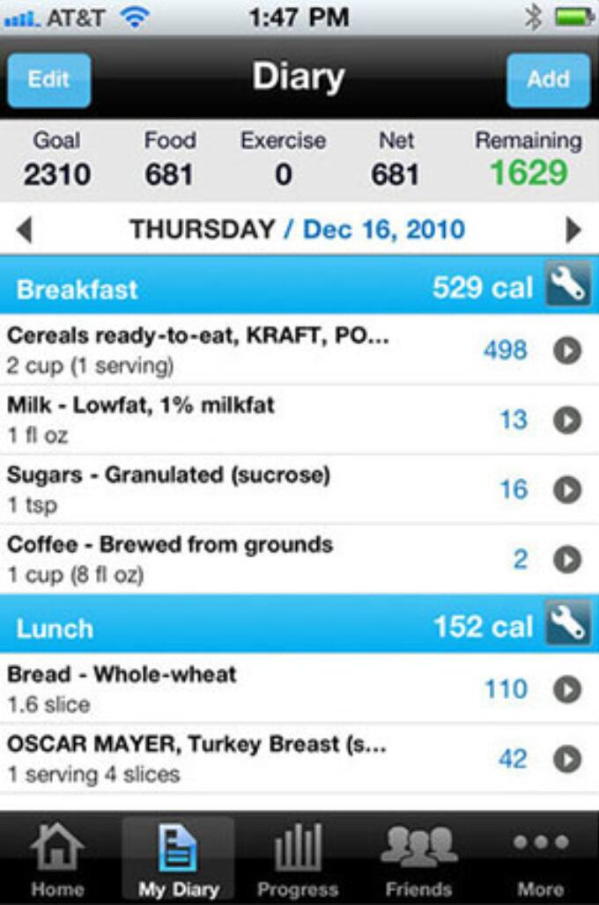
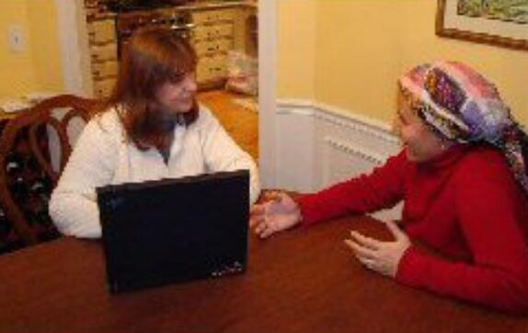
Self-report tools measuring EI
Self-report: 24-hour recall, food diary, database-assisted logs.
Problem:
Compliance (not easy to use for long period of time)
People underestimate/underreport true consumption by 10% to 50%

Slide 6
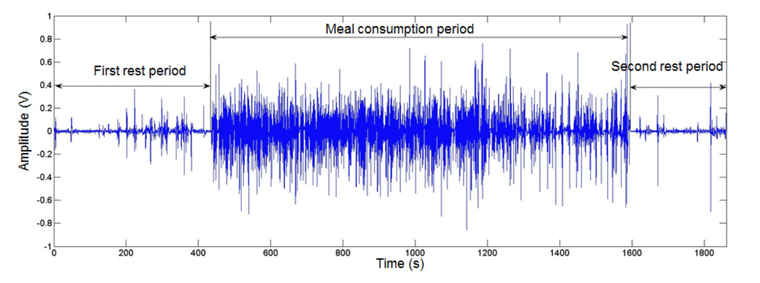
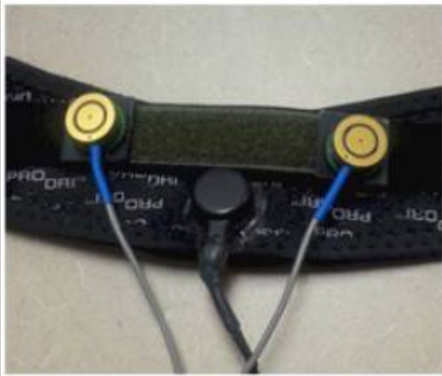
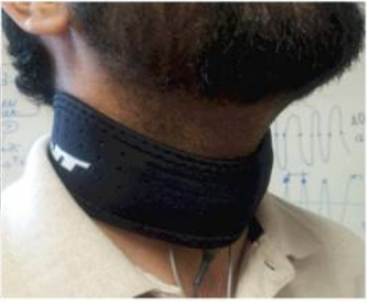
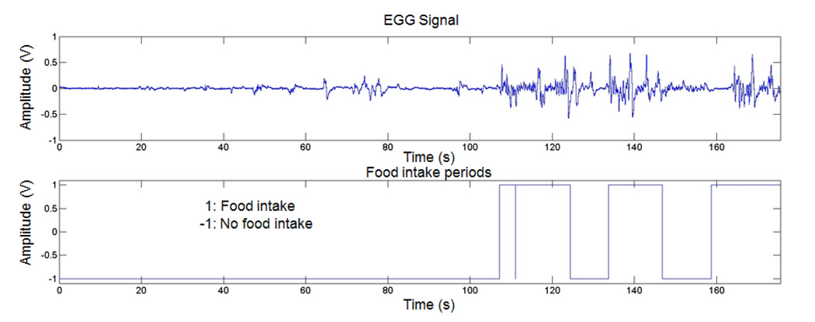
Wearable tools measuring EI
Wearable-sensors based approaches
Acoustic sensing systems: detect chewing or swallow sounds
Camera-based sensing systems
Motion-based sensing systems
Multimodal-based sensing systems

Slide 7
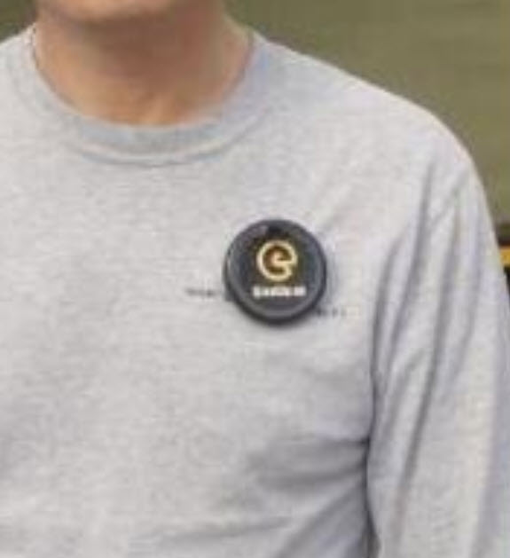
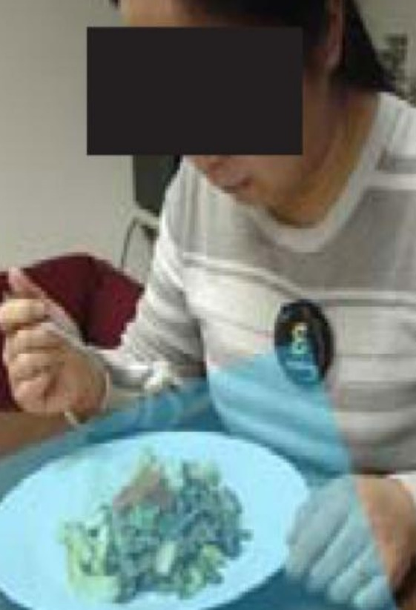
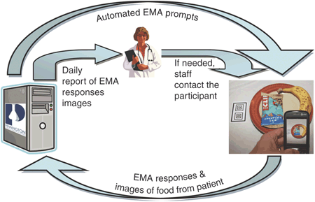
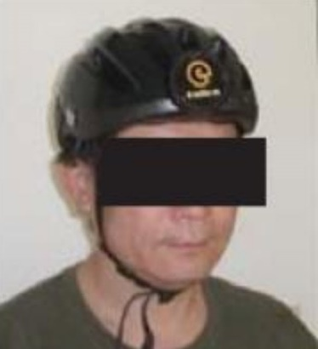
Wearable tools measuring EI
Wearable-sensors based approaches
Acoustic sensing systems
Camera-based sensing systems: capture image or videos while eating
Motion-based sensing systems
Multimodal-based sensing systems
(a) semi-auto food detection
(b) auto food detection

Slide 8
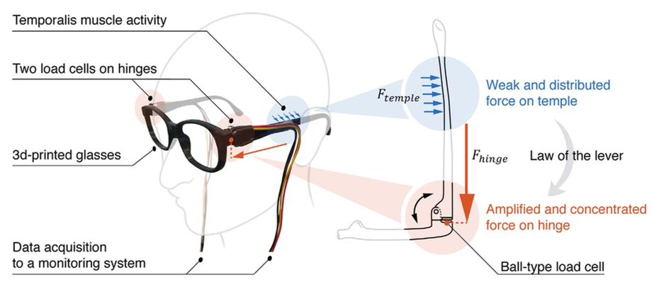
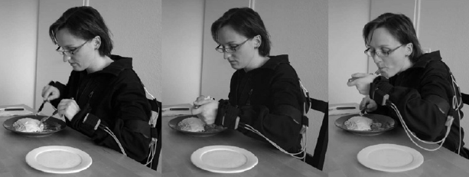
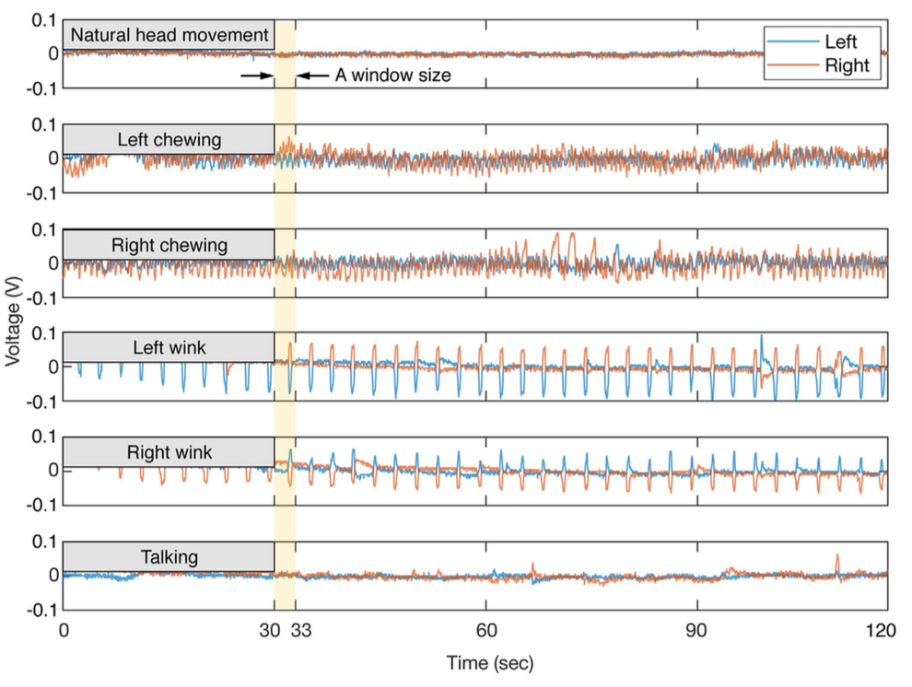
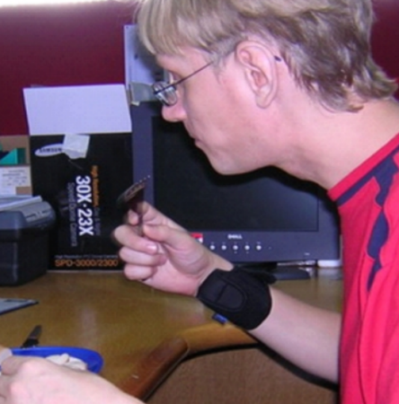
Wearable tools measuring EI
Wearable-sensors based approaches
Acoustic sensing systems
Camera-based sensing systems
Motion-based sensing systems: inertial sensors mounted on different body locations to detect eating activities
Multimodal-based sensing systems

Slide 9
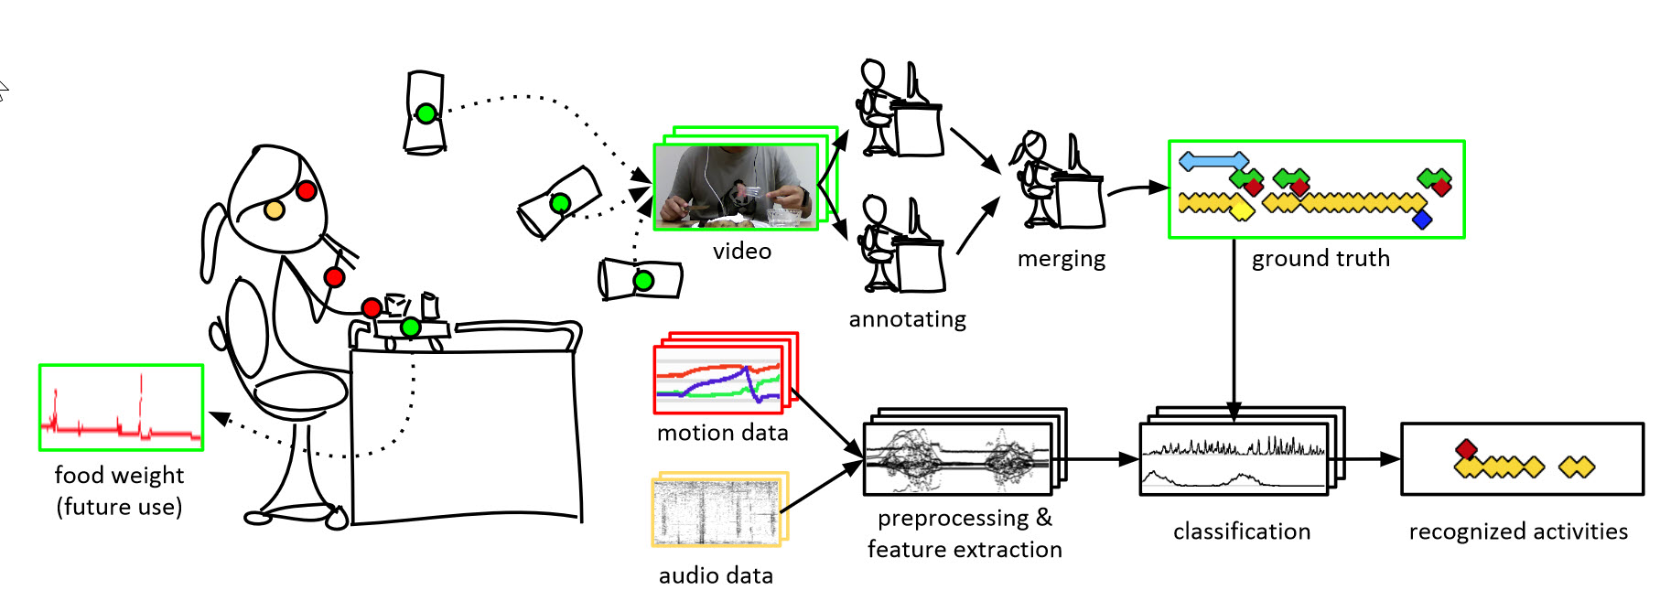

Wearable tools measuring EI
Wearable-sensors based approaches
Acoustic sensing systems
Camera-based sensing systems
Motion-based sensing systems
Multimodal-based sensing systems: sensor fusion on different body locations

Slide 10
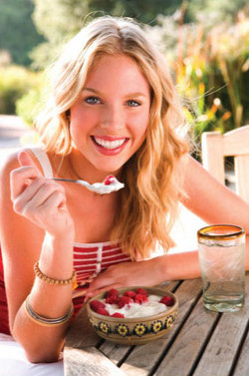
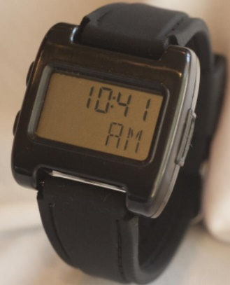
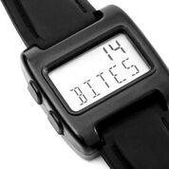
Our Method: Bite Counter
Tracks wrist motion to detect eating activities and count bites (hand-to-mouth gestures)
Audible alarms to queue behaviors such as slowing eating or portion control
Feedback during eating, as opposed to end of day
Worn like a watch!

Slide 11
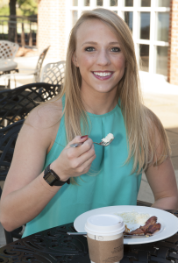
Previous work in our group
Detecting one type of gesture (called "bites" but includes any
food or liquid intake)
86% of bite/drink detected for 49 participants in a laboratory
setting (Dong et al. 2012)
An average per-individual correlation of 0.53 with detected bites
and self-recorded calories intake (Scisco et al. 2014)
The bite-based measure of kilocalorie intake outperformed
human estimates with and without kilocalorie information
(Salley et al. 2016)
Objective
Extend gesture vocabulary related to eating: intake gestures vs. non-intake gestures
Study the contextual information of wrist motions to improve eating gestures recognition

Slide 12
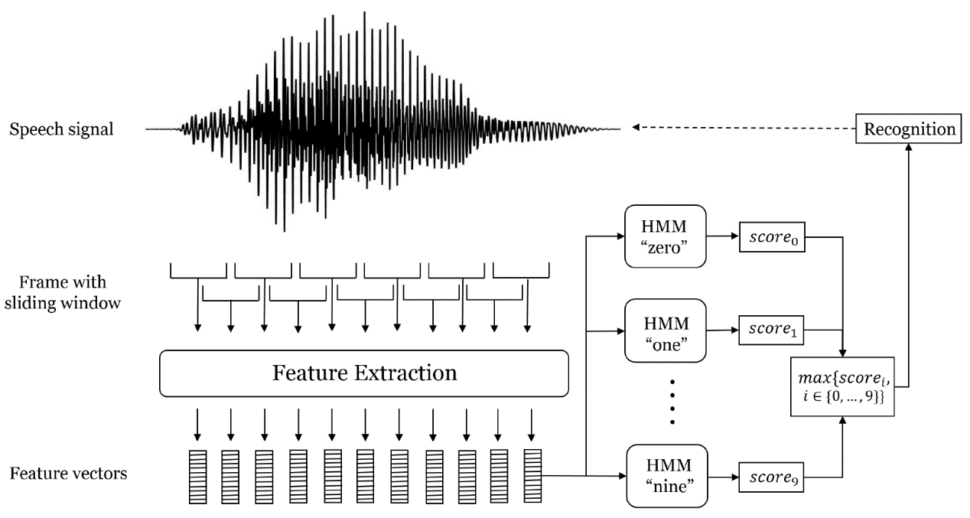
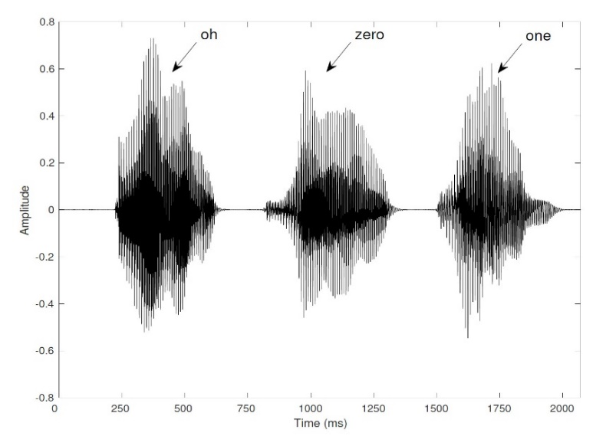
Our Idea: Learning from Speech Recognition
Speech is converted from analog to digital signal
Signal segment is divided into frames and features are extracted in each frame
Different models are built for each word

Slide 13
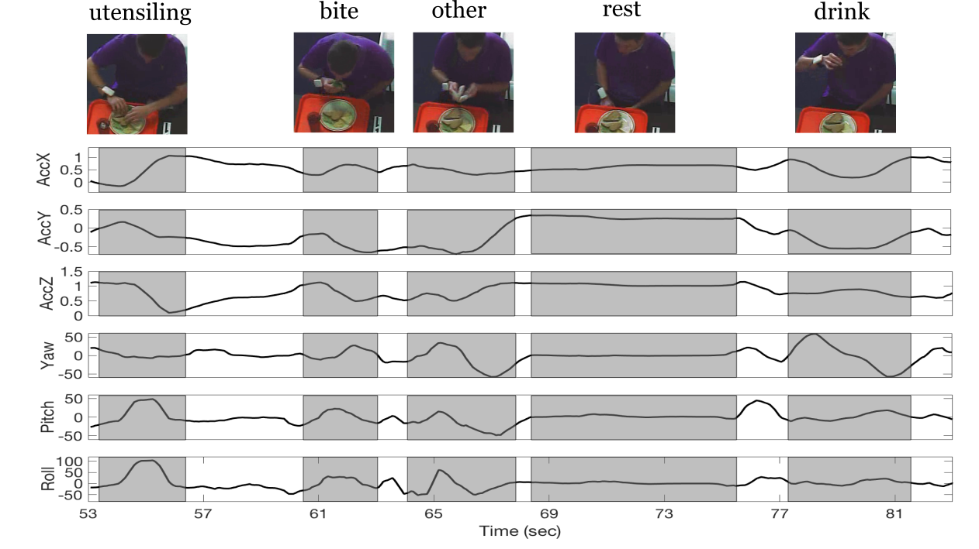
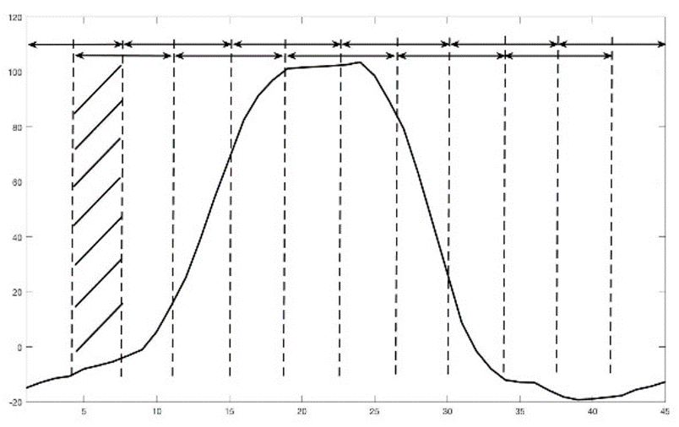
Our Idea: Learning from Speech Recognition
?
How to learn temporal structures in data: Hidden Markov Model (HMM)

Slide 14
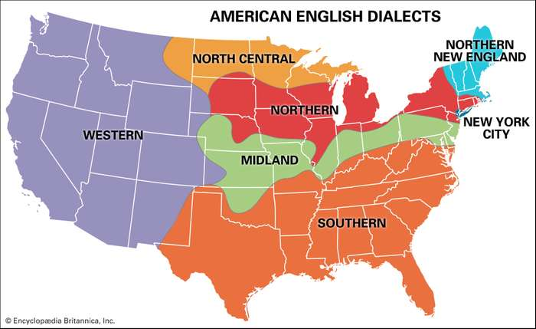
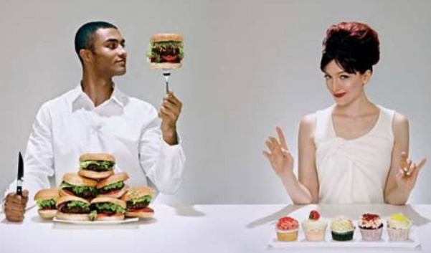
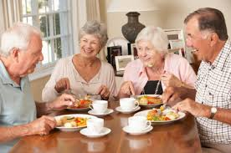
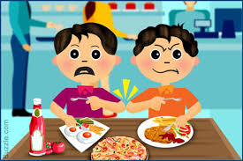
“Dialect” in Speech and Eating Activities
People from different regional groups speak the same language with variations in pronunciation, vocabularies, and grammars
What are the “dialects” in eating activities?
Gender?
Age?
Handedness?
…
Hypothesis: we use different contextual variables to find out the “dialects” in eating activities

Slide 15
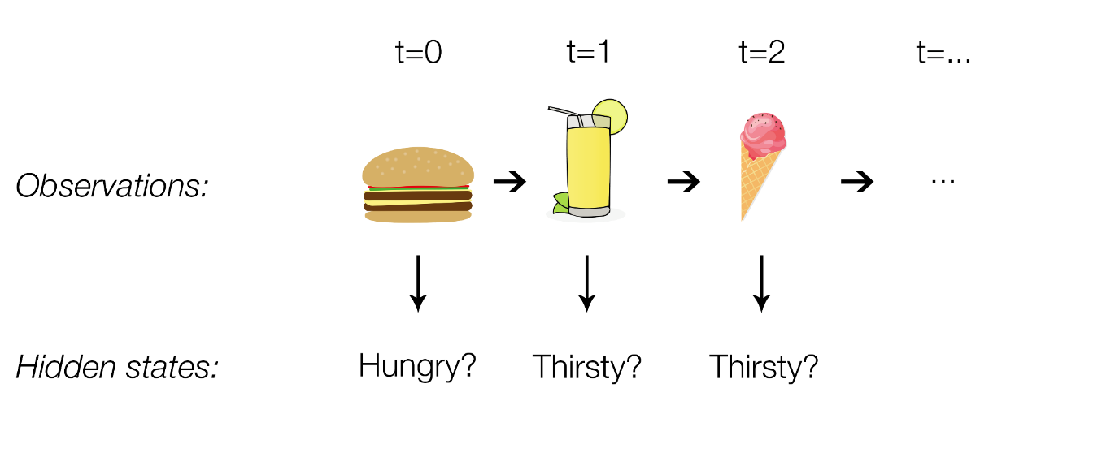
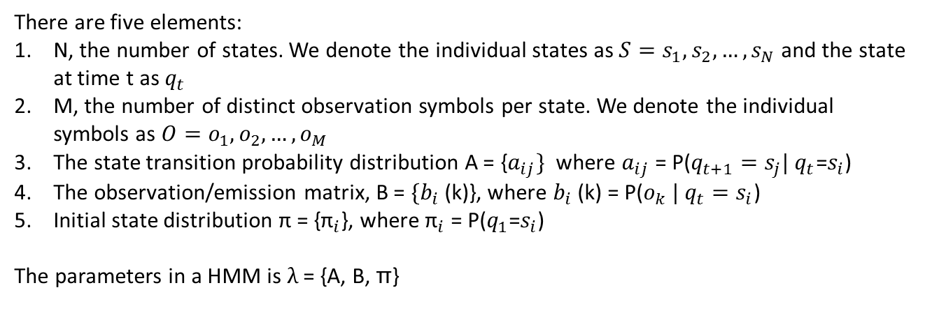
Hidden Markov Models (HMM)
HMM captures temporal sequence information.
There are five elements:
N, the number of states. We denote the individual states as ${S=s}_{1},s_{2}, …,s_{N}$ and the state at time t as $q_{t}$
M, the number of distinct observation symbols per state. We denote the individual symbols as ${O=o}_{1},o_{2}, …,o_{M}$
The state transition probability distribution A = {$a_{ij}\}$ where $a_{ij}$ = P($q_{t+1}=s_{j}| q_{t}$=$s_{i}$)
The observation/emission matrix, B = ${\{b}_{i}$(k)}, where $b_{i}$(k) = P($o_{k} | q_{t}=s_{i}$)
Initial state distribution π = {${\text{π}}_{i}$}, where ${\text{π}}_{i}$ = P($q_{1}$=$s_{i}$)
The parameters in a HMM is $λ$ = {A, B, π}

Slide 16
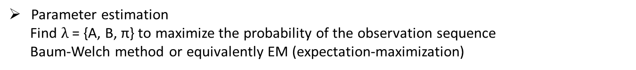
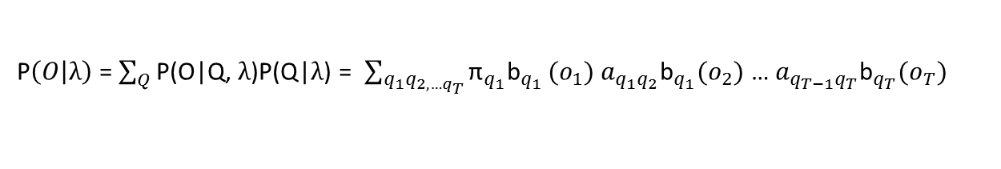
Three problems in HMM
Evaluation on observation sequence
P$\left(O | λ\right)$ = $\sum_{Q}{\text{P}\text{(}\text{O}\text{|}\text{Q}\text{, }λ\text{)}\text{P}\text{(}\text{Q}\text{|}λ\text{)}}$= $\sum_{q_{1}q_{2,…q_{T}}}{{\text{π}}_{q_{1}}{\text{b}}_{q_{1}}}{(o}_{1})$ $a_{q_{1}q_{2}}{\text{b}}_{q_{1}}{(o}_{2})$ … $a_{q_{T−1}q_{T}}{\text{b}}_{q_{T}}{(o}_{T})$
Problem: it requires to calculate the probability of every possible sequence, computationally expensive
Solution: use forward-backward algorithm to efficiently compute probability in two passes
State sequence decoding
Find the optimal state sequence that could best “explain” the observations: computationally exponential
Solution: use Viterbi algorithm to search states with max probability at each step
Parameter estimation
Find $λ$ = {A, B, π} to maximize the probability of the observation sequence
Baum-Welch method or equivalently EM (expectation-maximization)

Slide 17
Outline
Introduction
Non-HMM algorithm for eating detection: 1 word
Lexicography of hand gestures during eating: 5 words
Impact of the quantity of training data and model complexity: 5 words
Contextual dependent hidden Markov models: 5 words, multiple dialects

Slide 18
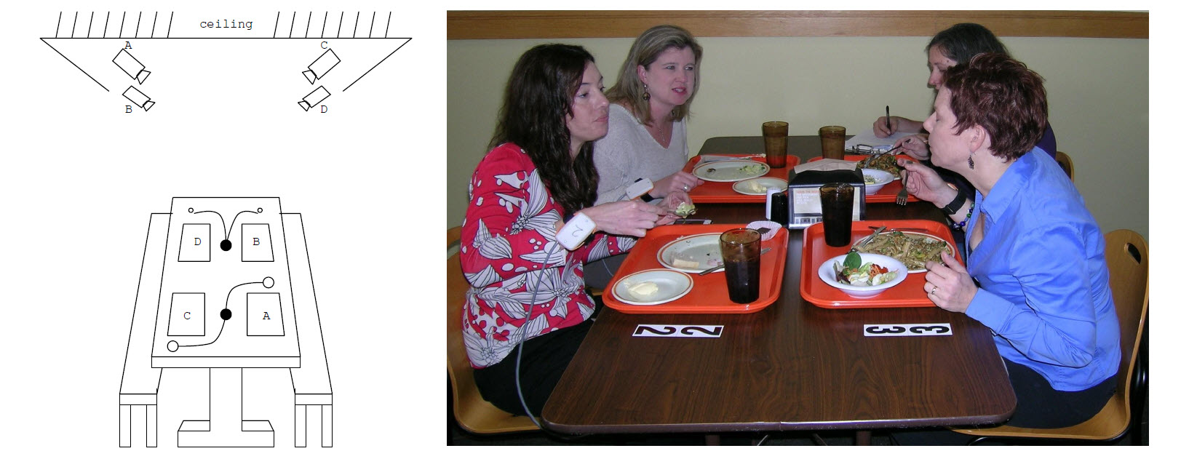
Data
Data was collected in Harcombe Dining Hall at Clemson University
Four digital video cameras in the ceiling recorded each participants mouth, torso during meal consumption
Bite counter containing MEMS accelerometers (STMicroelectronics LIS344ALH) and gyroscopes (STMicro-electronics LPR410AL) was used to record the wrist motion at 15 Hz
Total data includes 271 participants

Slide 19
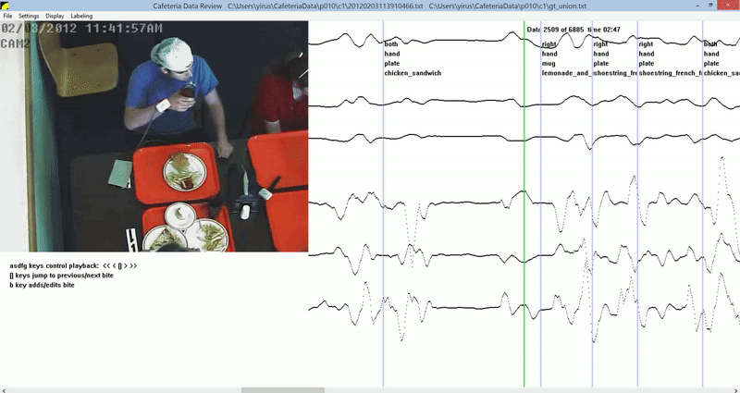
Ground Truth-Bites
AccX
AccY
AccZ
Yaw
Pitch
Roll
index of taking bite/drink
hand being used
utensil
container
food

Slide 20
Baseline: non-HMM algorithm
Goal: detect one type of gesture (“bite” but includes any food or liquid intake)
This can be related to the necessary orientations for:
picking food up
placing food into the mouth

Slide 21
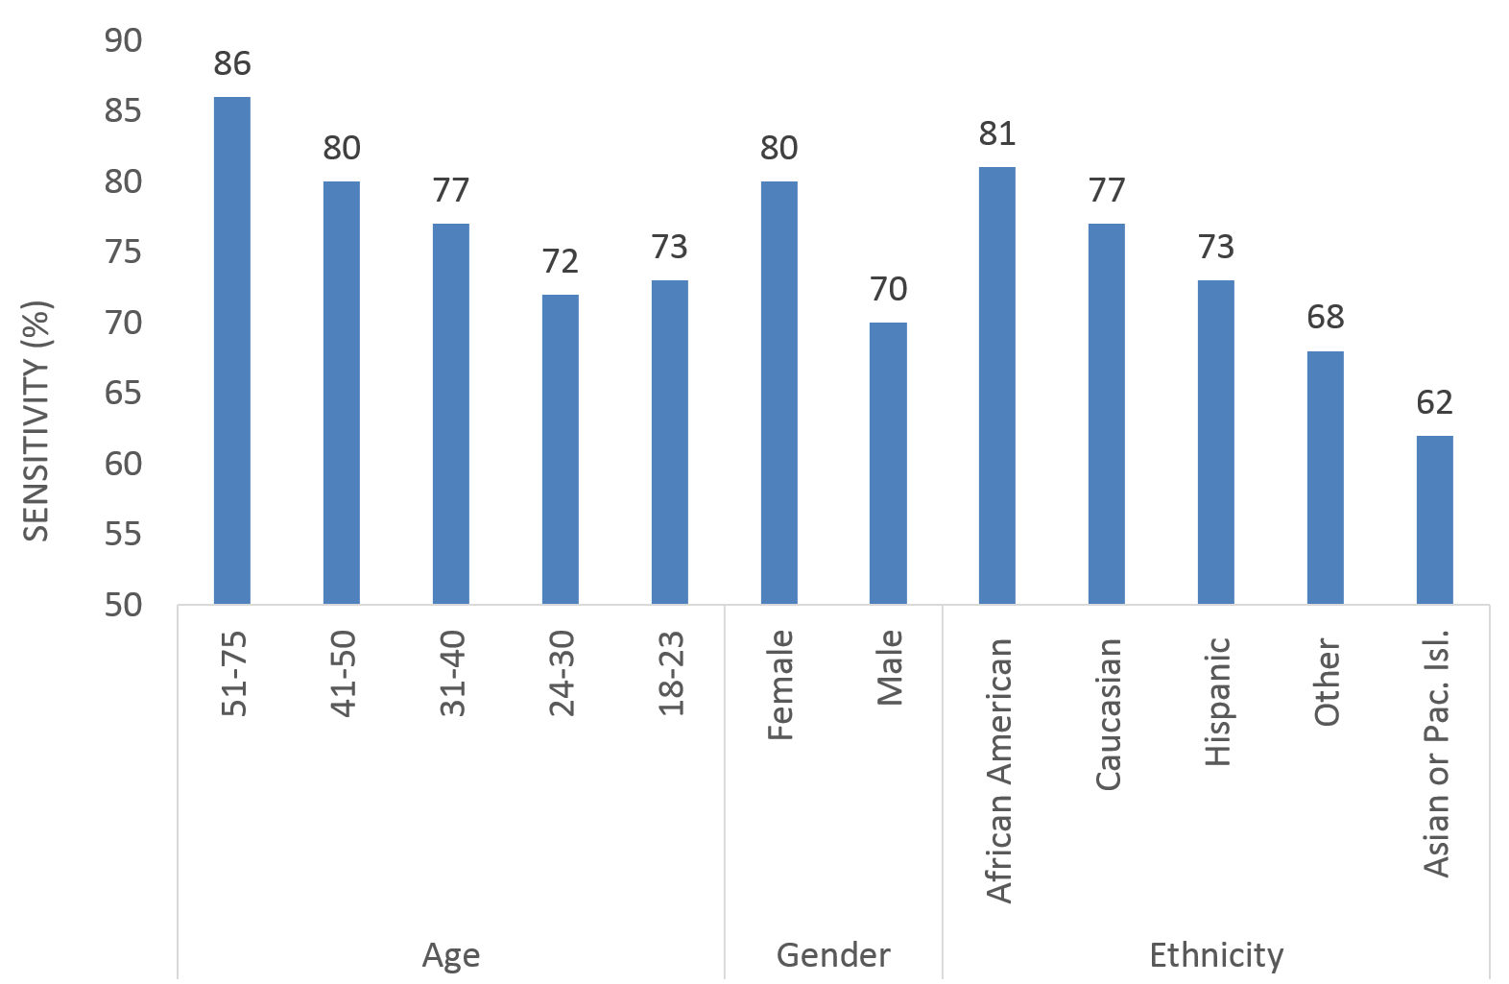
Bite Counting Results
Across all 24,088 bites the accuracy is 75%
Females showed a 10% higher accuracy than males
The largest discrepancy observed was due to ethnicity, with African Americans showing the highest accuracy and Asians/Pacic Islanders showing the lowest accuracy

Slide 22
Outline
Introduction
Non-HMM algorithm for eating detection: 1 word
Lexicography of hand gestures during eating: 5 words
Impact of the quantity of training data and model complexity: 5 words
Contextual dependent hidden Markov models: 5 words, multiple dialects

Slide 23
Approaches to Labeling Eating Activities
+
-
+
+
+
-
+
+
-
+
-
Window based approach:
equal intervals are labeled
Index based approach: a single
time index is labeled
Segment based approach:
the start and end index and the
event type are labeled
-
Window-based. +/-: event occurs or not.
Index-based. Vertical bar indicates event.
Segment-based. Variable length of segments with different colors indicate different event types and durations.

Slide 24
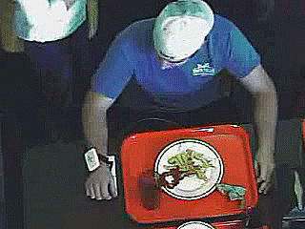
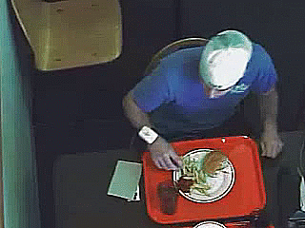
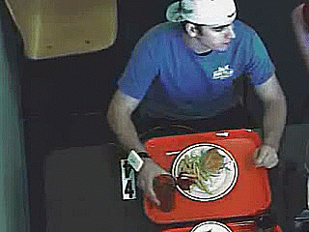
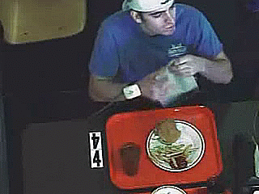
Eating Gestures
Eating gesture is a segment of time of an identifiable eating activity
Vocabulary: rest, utensiling, bite, drink and other
Each gesture is defined consisting of the following parts with at least 1 second duration:
the description of the activity
the start time of the activity
the end time of the activity
rest
utensiling
bite
drink
other

Slide 25
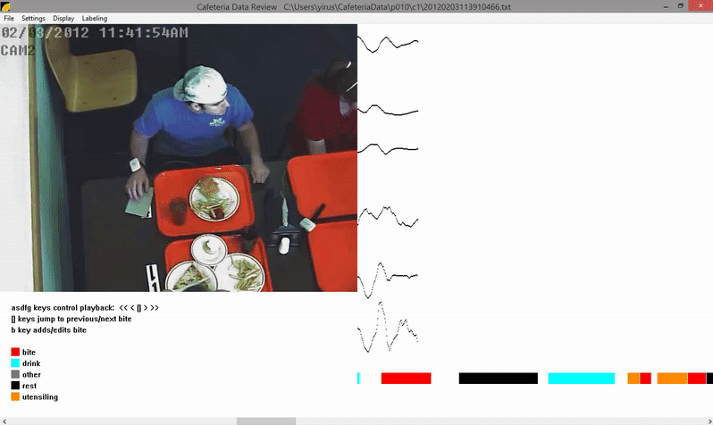


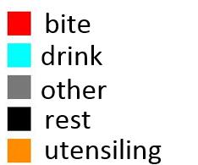
Ground Truth-Gestures
AccX
AccY
AccZ
Yaw
asdfg keys control playback: << < [] > >>
[] keys jump to previous/next bite
b keys adds/edits bite
Pitch
Roll
labels
18 Raters contributed to labeling gesture segments of 488 courses
The process of labeling a single meal took 60-120 minutes

Slide 26
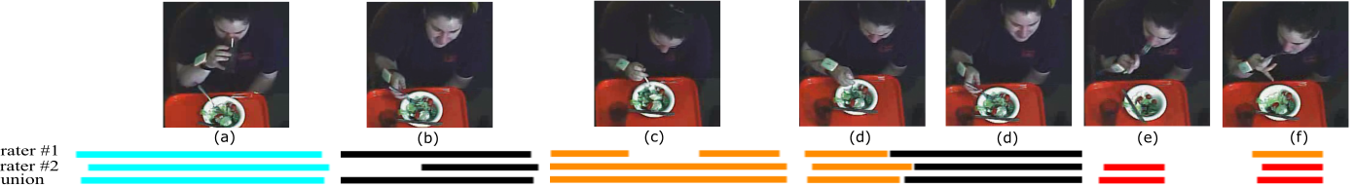
Inter-rater Reliability
For each gesture labeled by one rater, any overlapped gesture labeled from the second rater was examined. Cases to determine gesture matching:
Agreement
Boundary Ambiguity I
Boundary Ambiguity II
Boundary Ambiguity III
Mistake-missed
Mistake-identity
(a) Agreement
(b) Boundary
Ambiguity I
(c) Boundary
Ambiguity II
(d) Boundary
Ambiguity III
(e) Mistake-missed
(f) Mistake-identity

Slide 27
Results
Cases | #Gestures | Bite | Drink | Rest | Utensiling
Agreement | 13184 (75%) | 5814 (89.6%) | 594 (66.9%) | 2926 (58.9%) | 3850 (73.5%)
Overall Boundary ambiguity | 3064 (17.5%) | 635 (9.8%) | 277 (31.2%) | 1223 (24.6%) | 929 (17.7%)
Overall mistakes | 1328 (7.5%) | 37 (0.6%) | 17 (1.9%) | 817 (16.5%) | 457 (8.7%)
Overall agreement | 16248 (92.5%) | 6449 (99.4%) | 871 (98.1%) | 4149 (83.5%) | 4779 (91.3%)
A total of 51,614 gestures were manually labeled
Inter-rater reliability was conducted to determine the consistency of the gestures, with 92.5% agreement (75% exact agreement, 17.5% boundary ambiguity)
The usefulness of a third rater independently labeling each meal was explored. After 7 courses were labeled, the process was stopped. The mistake and ambiguity rate did not change

Slide 28
Outline
Introduction
Non-HMM algorithm for eating detection: 1 word
Lexicography of hand gestures during eating: 5 words
Impact of the quantity of training data and model complexity: 5 words
Contextual dependent hidden Markov models: 5 words, multiple dialects

Slide 29
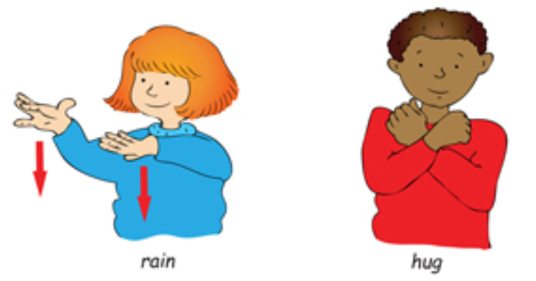
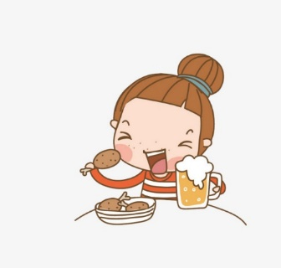
Gesture Recognition
Gesture recognition has been widely studied in sign language
Sign language gestures are designed to communicate intent
An HMM constructed with 3-4 states and 1-3 Gaussians
Training data for 24-60 samples per word
Eating gestures are a result of a physiological activity (eating)
Study | #Subjects | #Gestures
Amft et al. [7] | 2 | 384
Ye et al. [129] | 10 | 760
Thomaz et al. [117] | 14 | 1,184
Ramos-Garcia et al. [97] | 25 | 2,786
Ours | 269 | 51,614
lab
cafeteria
We provide context on the relationship between a laboratory experiment that demonstrates a proof-of-concept, and a potential deployment of the same method on a larger population

Slide 30
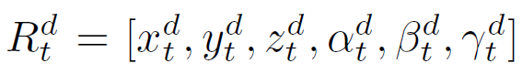
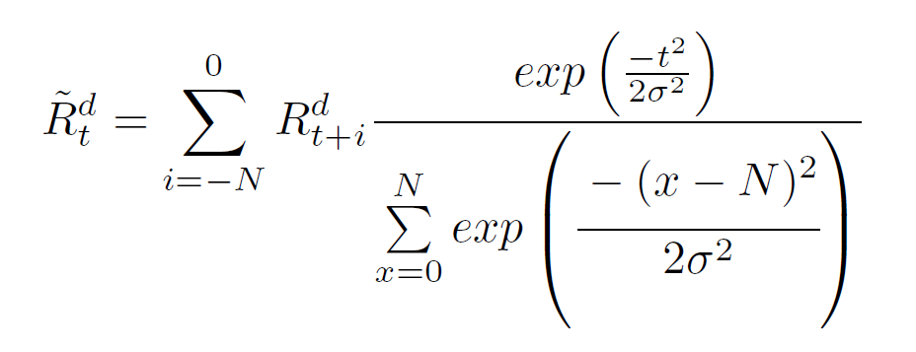

Data Preprocessing
Let the data set be comprised of d eating sessions
The wrist motion data is defined as
where x, y, z are accelerometer sensor readings and $α$, $β$, $γ$are gyroscope sensor readings
Data is smoothed using a Gaussian-weighted window of width 1s and standard deviation of $\frac{2}{3}$ s

Slide 31

Architecture
HMM-S: model a single gesture as a sequence of sub-gestures with each sub-gesture represented by a state
HMM-N: model a sequence of N previous gestures as context to improve recognition of the current gesture

Slide 32





HMM-S
Parameters in an HMM: $λ=\left\{π, A, B\right\}$
Observables with $w_{1}$ = 9 (0.6s) and $w_{2}=4 \left(0.3s\right)$
Gaussian mixture models (GMMs) are used to describe the emission probabilities B
where $c_{i},µ_{i},∑_{i}$ represent weight, mean and covariance matrix of the i-th Gaussian
Architecture: left-to-right with skip

Slide 33












HMM-N
A sequence of N previous gestures is modeled as context to improve recognition of the current gesture
$$HMM 1: P\left(g_{t}\right|g_{t−1})$$
$$g_{t−6}$$
$$g_{t−5}$$
$$g_{t−4}$$
$$g_{t−3}$$
$$g_{t−2}$$
$$g_{t−1}$$
$$g_{t}$$
?
utensiling
bite
utensiling
bite
rest
drink
$$HMM3: P\left(g\right|g_{t−1}g_{t−2}g_{t−3})$$
$$HMM2: P\left(g_{t}\right|g_{t−1}g_{t−2})$$
Similarly,
$$HMM4: P\left(g_{t}\right|g_{t−1}g_{t−2}g_{t−3}g_{t−4})$$
$$HMM5: P\left(g_{t}\right|g_{t−1}g_{t−2}g_{t−3}g_{t−4}g_{t−5})$$
$$HMM6: P{\left(g_{t}\right|g}_{t−1}g_{t−2}g_{t−3}g_{t−4}g_{t−5}g_{t−6})$$

Slide 34


HMM-N
In HMM-N, each state is represented as $s_{i}=\left\{g_{1}g_{2}…g_{N}\right\}$, e.g. BB in HMM-2 is one state
To calculate the state transition matrix, HMM-N is converted to an equivalent 1st-order HMM Transitions between some states are impossible, e.g. BB to DB
In total HMM-N has only $5^{N}×5$ possible state transitions
State transitions in HMM-2

Slide 35





HMM-N
Prior
State transition A
Emission probability B
Assume observables are only dependent on the most recent gesture
Recognition:
Finding the most likely state sequence (Viterbi algorithm)
The most recent gesture in each qt determines the gesture type for each time step
$$Q=\{q_{1}q_{2}…q_{T}\}$$

Slide 36

Model Complexity
#states N (N = 3…25) and the number of Gaussians M (M=1…7) for HMM-S were varied
Training data: 650 per gesture type, testing: 650 per gesture type
Each model was run 5 times and the average is reported

Slide 37

Impact of Training Data
N = 13, M= 5 for each HMM
#training samples per gesture type was varied from 65 to 650 by randomly selecting from the full data set
During recognition, the same set of testing data as above was used
Each model was run 30 times and the average is reported
+8%

Slide 38



Results
Recognition accuracy for HMM-S and HMM-1
+1.8%
#Parameters in HMM-N. Note: observable is 5-dimensional vector and 7 GMMs are used.
+0.9%
All classifiers were trained and tested using five-fold cross validation
For each gesture, the improved accuracy from HMM-S to HMM-1 for rest, utensiling and bite is 2.2%, 4.3%, 8.2%, respectively
We observe that drink and other decrease in accuracy from HMM-S to HMM-1, suggesting that there is not enough sequencing consistency in their occurrence
Based on the one in ten rule, we don’t have enough data to train HMM-5 and HMM-6

Slide 39
Baseline Results
 | #words | Original expr. |  |  | Expr. in this dissertation
 |  | #N | Accuracy (%) |  | #N | Accuracy (%)
 |  |  | All gestures | Intake gestures |  | All gestures | Intake gestures
Non-HMM | 1 | 49 | 81.0% | 81.0% | 271 | - | 75.0%
HMM-S | 5 | 25 | 84.3% | - | 269 | 85.2% | 85.0%
HMM-1 | 5 | 25 | 87.7% | - | 269 | 89.5% | 91.5%
3 baseline experiments
Original vs. replicated experiments:
Non-HMM: laboratory vs. unscripted (cafeteria)
HMM-S: +0.9%
HMM-1: +1.8%

Slide 40
Outline
Introduction
Non-HMM algorithm for eating detection: 1 word
Lexicography of hand gestures during eating: 5 words
Impact of the quantity of training data and model complexity: 5 words
Contextual dependent hidden Markov models: 5 words, multiple dialects

Slide 41








Contextual HMMs: top-down approach
Demographics
Gender HMMs
Age HMMs
Handedness HMMs
Ethnicity HMMs
BMI HMMs
Meal level
Utensil HMMs
Food HMMs
Language variations
Bite variational HMMs
Utensiling variational HMMs
Other variational HMMs
Age HMMs
Bite variational HMMs
Food HMMs
Gender HMMs

Slide 42


Demographics HMMs
Demographics (gender, age, handedness, ethnicity, BMI) is known a priori
Demographics | #HMMs
Gender | 10
Age | 20
Handedness | 10
Ethnicity | 25
BMI | 15
Recognition of gender HMMs

Slide 43


Meal level HMMs
Utensil being used and food types being consumed in each meal is known a priori
Food HMMs: food with accuracy $≥$75% (high accuracy), [60% ,75%] (mid accuracy), $<$60% (low accuracy) based on the non-HMM, and mixed food type
Meal level | #HMMs
Utensil | 25
Food | 20

Slide 44



Language variation HMMs
A large variety of motion patterns in the 5 gesture vocabulary. Extend the current gesture vocabulary to capture these variations
Bite variational HMMs
Utensiling variational HMMs
Other variational HMMs
#gestures of bite variations.
#gestures of utensiling variations.
Recognition of bite variational HMMs

Slide 45


Language variation HMMs
Other variational HMMs
#gestures of utensiling variations
Language variation HMMs | #HMMs
Bite variational HMMs | 9
Utensiling variational HMMs | 10
Other variational HMMs | 6
Log scores of other compared with rest, utensiling, bite and drink

Slide 46







Contextual HMMs: bottom-up approach
Extend sub-vocabularies of bite
Log-score clustered HMMs
K-means clustered HMMs
…
top 50%
…
8 bite clusters from log scores
…
bottom 50%
…
1st split
2nd split
3rd split

Slide 47


K-means clustered HMMs
Roll motion of bite from eight clusters by k-means
Black curve indicates the averaged roll motion and the standard deviation, gray curves indicate the instances in each cluster

Slide 48

Contextual HMMs with one gesture history
Bite variational HMMs with one gesture history
Log-score clustered HMMs with one gesture history
K-means clustered HMMs with one gesture history
State transition for HMM-1 and bite variational HMM

Slide 49


Results - Overall
All classifiers were trained and tested using five-fold cross validation
+6.7%
+1.2%
-0.6%
+1.5%

Slide 50

Results – Gesture Type
The maximum improvements of rest, utensiling, bite, drink and other are: 1.4%, 5.2%, 9.7%, 0.6% and 9.3%, respectively
Modeling eating "dialects" can improve recognition accuracy

Slide 51

Accuracy Bound of Contextual HMMs
We investigate the #gestures that are failed to recognize w.r.t. the amount of contextual HMMs
#gestures that are failed to recognize reaches the plateau when around 7 contextual HMMs are applied

Slide 52
Results of All Models
 | #words | Original expr. |  |  | Expr. in this dissertation
 |  | #N | Accuracy (%) |  | #N | Accuracy (%)
 |  |  | All gestures | Intake gestures |  | All gestures | Intake gestures
Non-HMM | 1 | 49 | 81.0% | 81.0% | 271 | - | 75.0%
HMM-S | 5 | 25 | 84.3% | - | 269 | 85.2% | 85.0%
HMM-1 | 5 | 25 | 87.7% | - | 269 | 89.5% | 91.5%
Context HMM-S | 5 | - | - | - | 269 | 86.4% | 91.7%
Context HMM-1 | 5 | - | - | - | 269 | 88.9% | 93.0%
+1.2%
+6.7%
-0.6%
+1.5%

Slide 53



Examples of failures
Although intake gesture accuracy is improved up to 6.7%, all gestures accuracy in contextual HMMs does not improve much (up to 1.2%)
A large motion variations in other, with the accuracy between 40.4% and 61.9%
Some gestures are confusing:
More head-towards-plate motions when a food is prone to spillage.
Challenging to recognize gestures with short duration

Slide 54

Conclusions
Modeling eating "dialects" can improve recognition
accuracy
5 gestures are defined
The Inter-rater reliability evaluated the consistency
of the definitions in a large dataset of 488 courses,
showing the overall agreement rate of 92.4%
Three baselines:
Non-HMM algorithm: 75.0% accuracy
Generic HMMs: 85.2% all gestures, and 85.0% intake gestures
Generic HMMs with one history: 89.5% all gestures, 91.5% intake gestures
Findings:
Contextual HMMs: up to 86.4% all gestures, 91.7% intake gestures
+1.2% all gestures, +6.7% intake gestures over generic HMMs
Contextual HMMs with one gesture history: up to 88.9% all gestures, 93.0% intake gestures.
-0.6% all gestures, +1.5% intake gestures over generic HMMs with one history

Slide 55


Future Work – Automatically Segmentation
A 1s window centered at each time index: eating or non-eating
Observables with 18 dimension are computed in each window
2 HMMs are trained:
Non-eating HMM & eating HMM
13 states & 5 Gaussians
Training & testing using the same data
Output: $log(\frac{eating}{non−eating})$

Slide 56
Thank you! Questions?

